Slide 1
Individual differences and Alternative curriculum
Orientation programme for classes VI-VIII

Slide 2
Individual differences
Plato stated more than 2000 years ago:
No two persons are born exactly alike; but each differs from the other in natural endowments, one being suited for one occupation and the other for another.
Children are just different from one another
The key to success is to tailor the rearing environment to the developmental level of the child--what she or he can handle--and to individual differences among children.
Respect for individual differences is in my view the cornerstone of good parent-child relationships. Sandra Wood Scarr American Psychologist

Slide 3
Individual differences
Difference in learning capability
Difference in interest
Difference in aptitude
Difference in motivation

Slide 4
Alternative curriculum
TRADITIONAL SYSTEM
TEACHER TAUGHT
SPATIO-TEMPORAL FIXEDNESS
CURRICULUM FIXEDNESS
PARIDGM SHIFT
CORRESPONDENCE
EDUCATION
SELF LEARNING
FREEDOM OF LOCATION
CURRICULUM FIXEDNESS
PARIDGM SHIFT
SELF LEARNING/ TEACHING SUPPORT
FREEDOM OF LOCATION
FREEDOM TO LEARN
ODL EDUCATIONAL SYSTEM

Slide 6
National Institute of Open schooling (NIOS)
The National Institute of Open Schooling (NIOS) formerly known as National Open School (NOS) was established in November,1989 as an autonomous organization in pursuance of National Policy on Education 1986 by the Ministry of Human Resource Development (MHRD), Government of India.
It was started as a project with in-built flexibilities by the Central Board of Secondary Education (CBSE) in 1979

Slide 7
What does NIOS do?
The National Institute of Open Schooling (NIOS) provides opportunities to interested learners by making available the following Courses/Programmes of Study through open and distance learning (ODL) mode.
Open Basic Education (OBE)
Secondary Education Course
Senior Secondary Education Course
Vocational Education Courses/Programmes
Life Enrichment Programmes

Slide 8
OPEN BASIC Education
The OBE Programme is offered at three levels:
OBE level A : equivalent to class I-III
OBE level B : equivalent to class IV-V
OBE level C : equivalent to class VI-VIII

Slide 9
Secondary Education Course
This Course is equivalent to the Xth standard. Students can choose subjects from the scheme of studies given. Students should be 14 years old
However, students will be required to successfully complete a minimum of five subjects with at least one language or at most two languages, which is compulsory for certification.
Two additional subject can also be taken.

Slide 10
Subject choices under Secondary School
Group-A(one or two) Hindi(201), English(202), Bengali(203), Marathi(204), Telugu(205), Urdu(206), Gujarati(207), Kannada(208), Sanskrit(209), Punjabi(210), Assamese (228),Nepali(231), Malayalam(232), Oriya(233), Arabic (235),Persian (236), Tamil (237)
Group-B(three or four) Mathematics(211), *Science(212), Social Science(213), Economics(214), Business Studies(215), *Home Science(216), *Word Processing(E)(219), Psychology (222), Indian Culture & Heritage (223), *Painting (225)

Slide 11
Vocational and life enrichment activities
NIOS offers various vocational courses along with these basic and secondary courses. The objective is to teach students about target skills in various fields such as Agriculture and Animal Husbandry; Business, Accounts and Commerce, IT and Technology; Engineering and Architecture, Health and Paramedical Science, Home Science, Hospitality, Management programs, Teacher Training and much more. There are more than hundred types of vocational courses which can be selected by the students as per their interests.
Life enrichment courses are conducted as certified examination courses in music, dance, yoga, women empowerment

Slide 12
Regional Centre
Regional Centre Office of the Director (Vocational Education), 3rd floor, PUE Bhavan, 18th Cross Sampige Road, Malleswaram, Bengaluru, Karnataka-560 012
Tel (o) : 23464223

Slide 13
Other study centres
There are also some schools who teach NIOS syllabus in regular classes from 8th Standard onwards.
Cluny Convent High School
Iyer High School
Nehru Open School
Baldwins Girls High School
Kensri School
Parijma Learning Centre
Larkspur House of Learning
Spastic Society of Karnataka

Slide 14
Fee Structure
Stream I for New enrolment
Stream II for students who could not clear their exam
Stream III Secondary on demand exam
Stream IV Sr secondary on demand exam
Starts from Rs.1700 + academic material

Slide 15
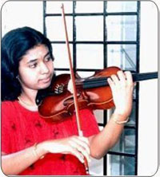
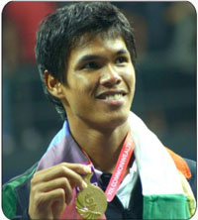
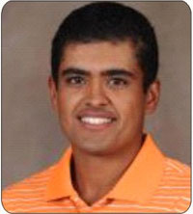
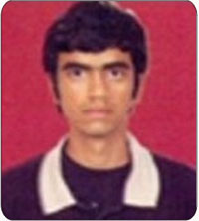
Proud and Successful learners from NIOS
Mary KOM Kavya Madhavan L. Athira Krishna Dr. Prabhleen Singh
Boxing Champian Kerala's Leading Actress An International Violinist/Guinness
State Award Winner World Record Holder
Amanjyot Singh
International
Golf Player
Somdev Devvarman Varun Thakkar
India's First Tennis Gold Medalist in the Commonwealth Games Sailing Champion

Slide 16
Companies
Students from NIOS have settled in various organisations like
NRHM (National Rural Health Mission)
Reliance
Reliance India mobile
ICICI Bank
HDFC Bank
Data Processing Unit

Slide 17
The NIOS WEBSITE www.nios.ac.in
Information dissemination
24x7 online admission
Course material
Evaluation/assessment papers for practice
Tutor marked assignments
Student information regarding admission and examination dates
List of Study centers
Other related matter

